Slide 1
Transitional Kindergarten & Kindergarten
Information Night - 2025
Welcome to Pattengill Elementary School!

Slide 2
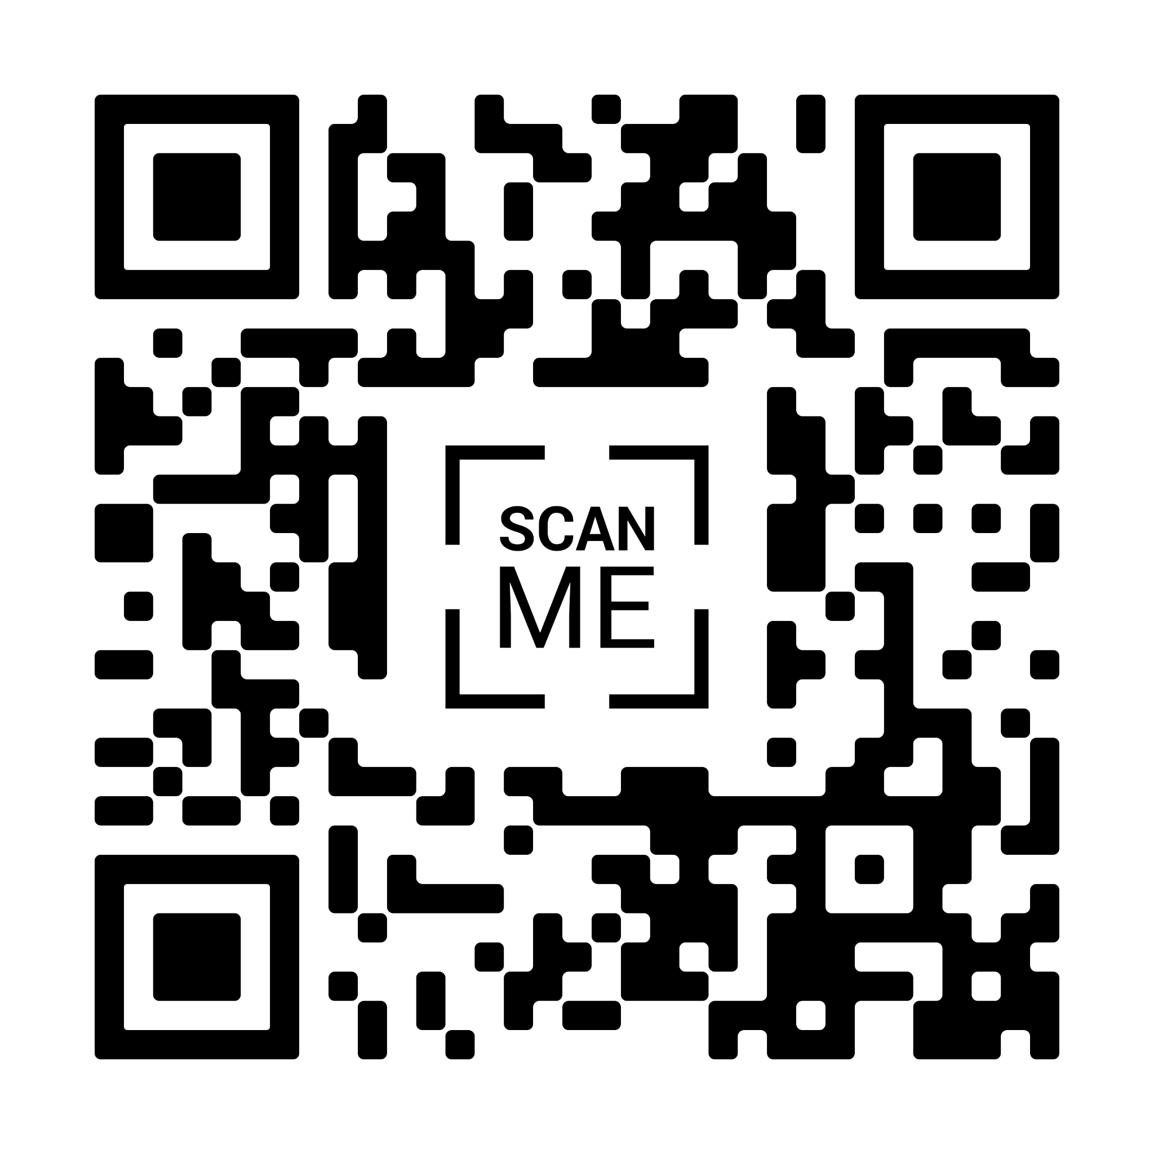
Tonight’s Agenda
Welcome - please fill out the attendance sheet
Handouts
Presentation
Meet the Pattengill PTA and Dads Club
Questions
Tour of the building
Parents and school staff available for questions

Slide 3
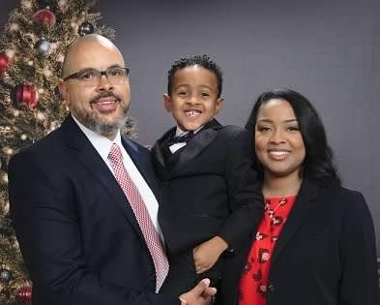
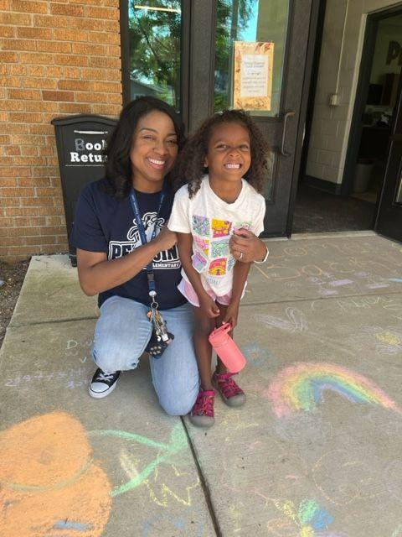
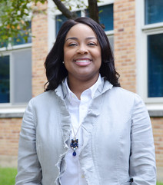
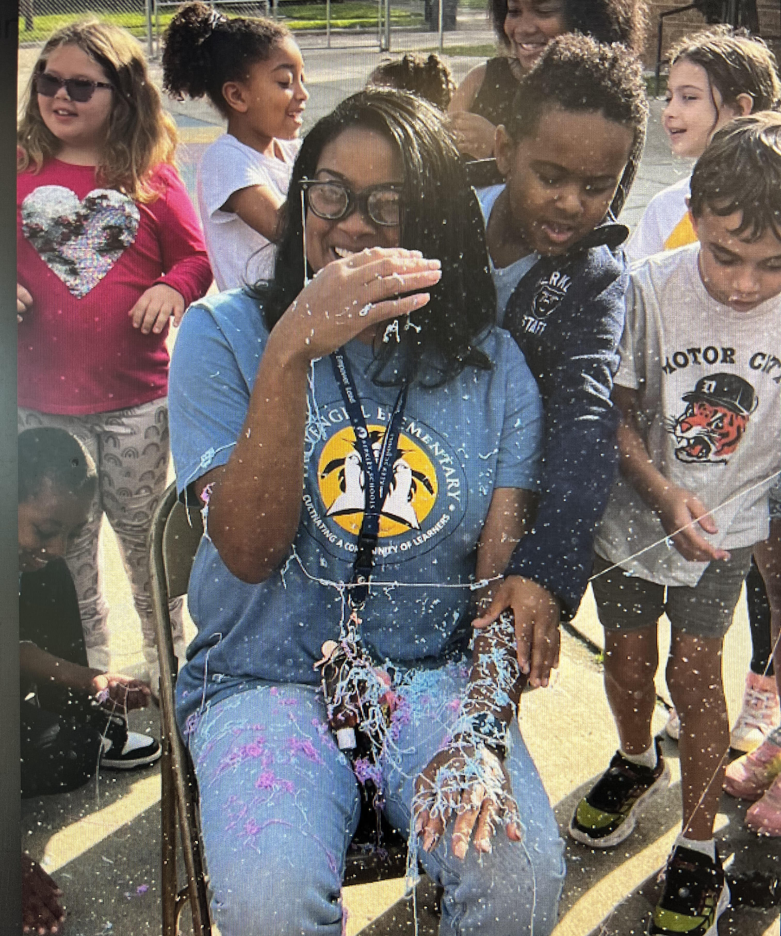
Principal’s Welcome
Thank you for your interest in Pattengill Elementary School.
We are so pleased you will be joining us for the fall of 2025.
Pattengill has an amazing teaching and support staff.
Our school is a warm and inviting place to learn and grow.
Shamika Womble, Principal
shamika.womble@berkleyschools.org
(248) 873-8700

Slide 4
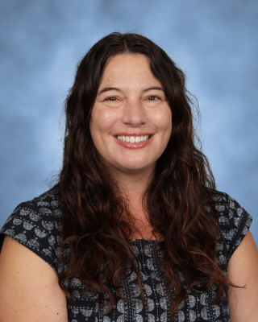
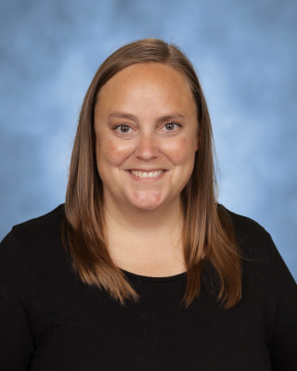
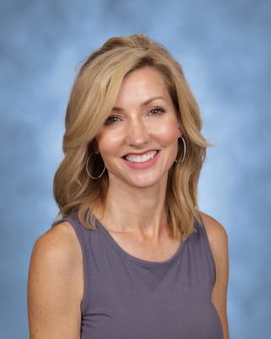
Transitional Kindergarten & Kindergarten Staff
Molly Borgon, Kindergarten Stacey McConnell, Kindergarten
Sarah Bruce, TK

Slide 5
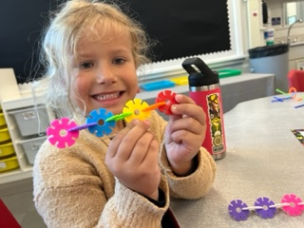
Our Programs
Kindergarten
All Schools
Transitional Kindergarten
District program
Location(s) TBD
Full day of learning, including:
Independent learning
Whole group learning
Small group learning
Specials classes
Recess
Lunch (new multi-purpose room!)
New flexible furniture!

Slide 6
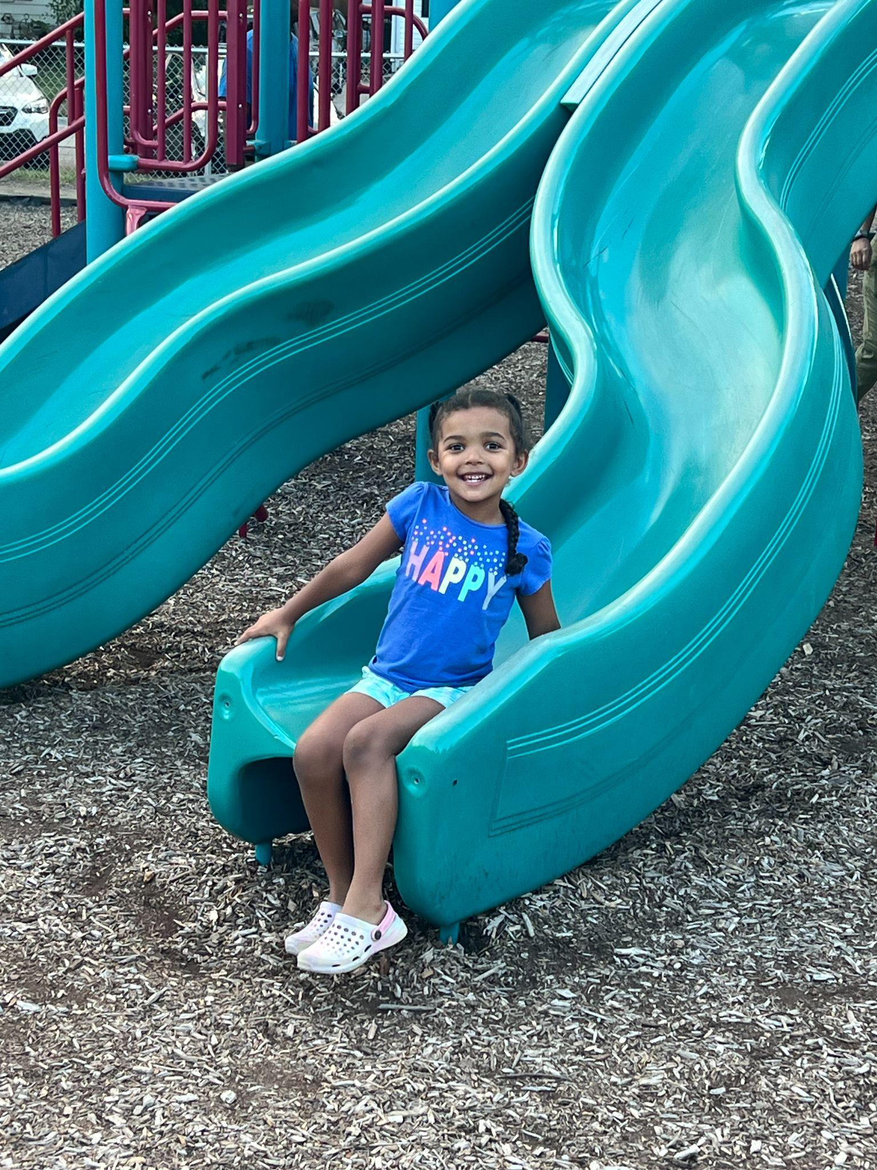
Kids’ Zone Latchkey
Before and after school care is available, as space allows:
Angell, Pattengill, Rogers and Norup - Berkley Schools Kids' Zone Latchkey Program
Burton - Huntington Woods Recreation Center (PM)
Each section (AM & PM) must have a minimum of 18 students to run
New student enrollment window: May 23-30.
Register at Berkley Building Blocks, forms are online: www.berkleyschools.org/kidszone

Slide 7
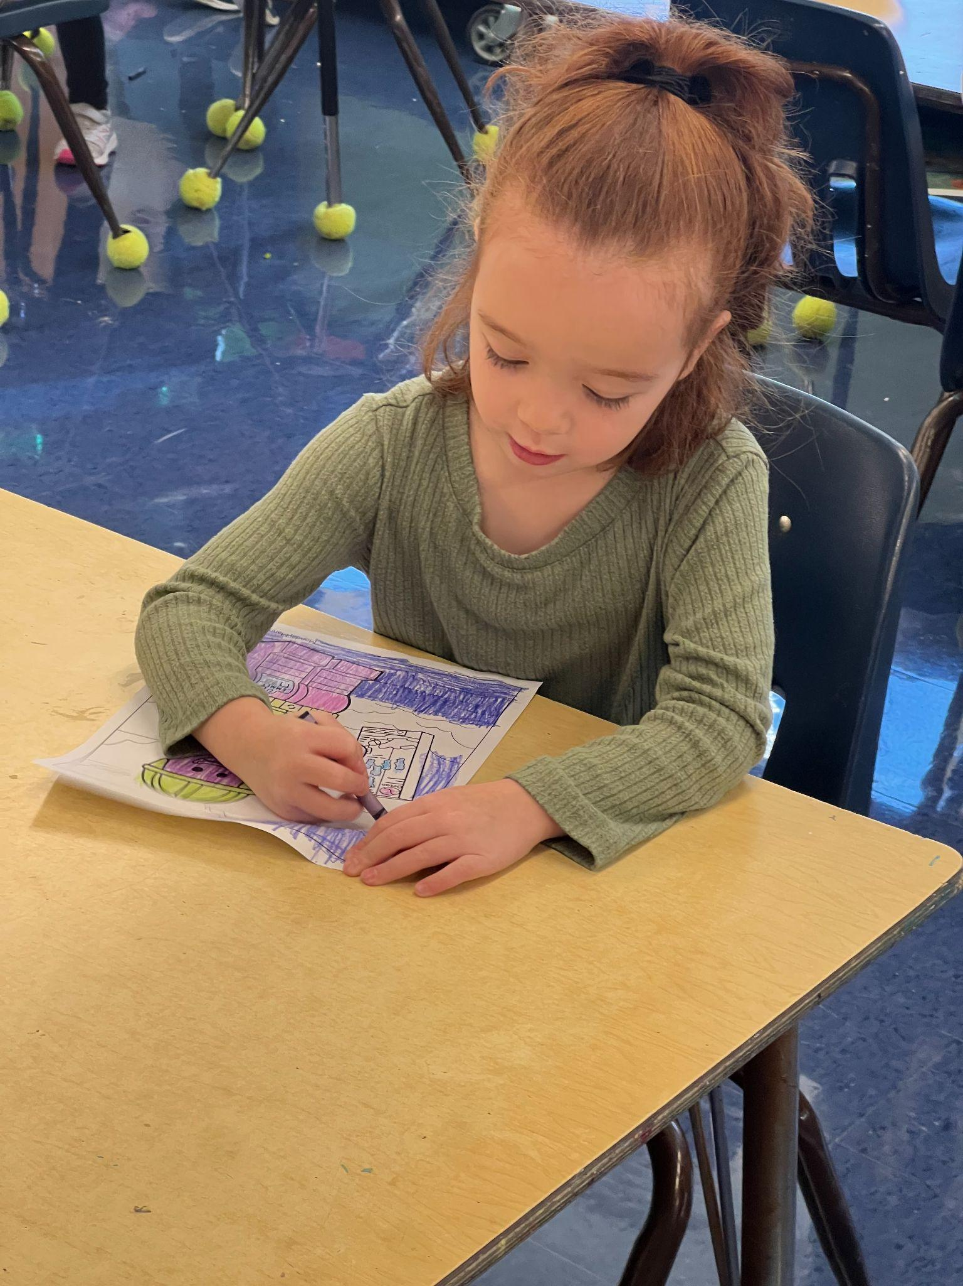
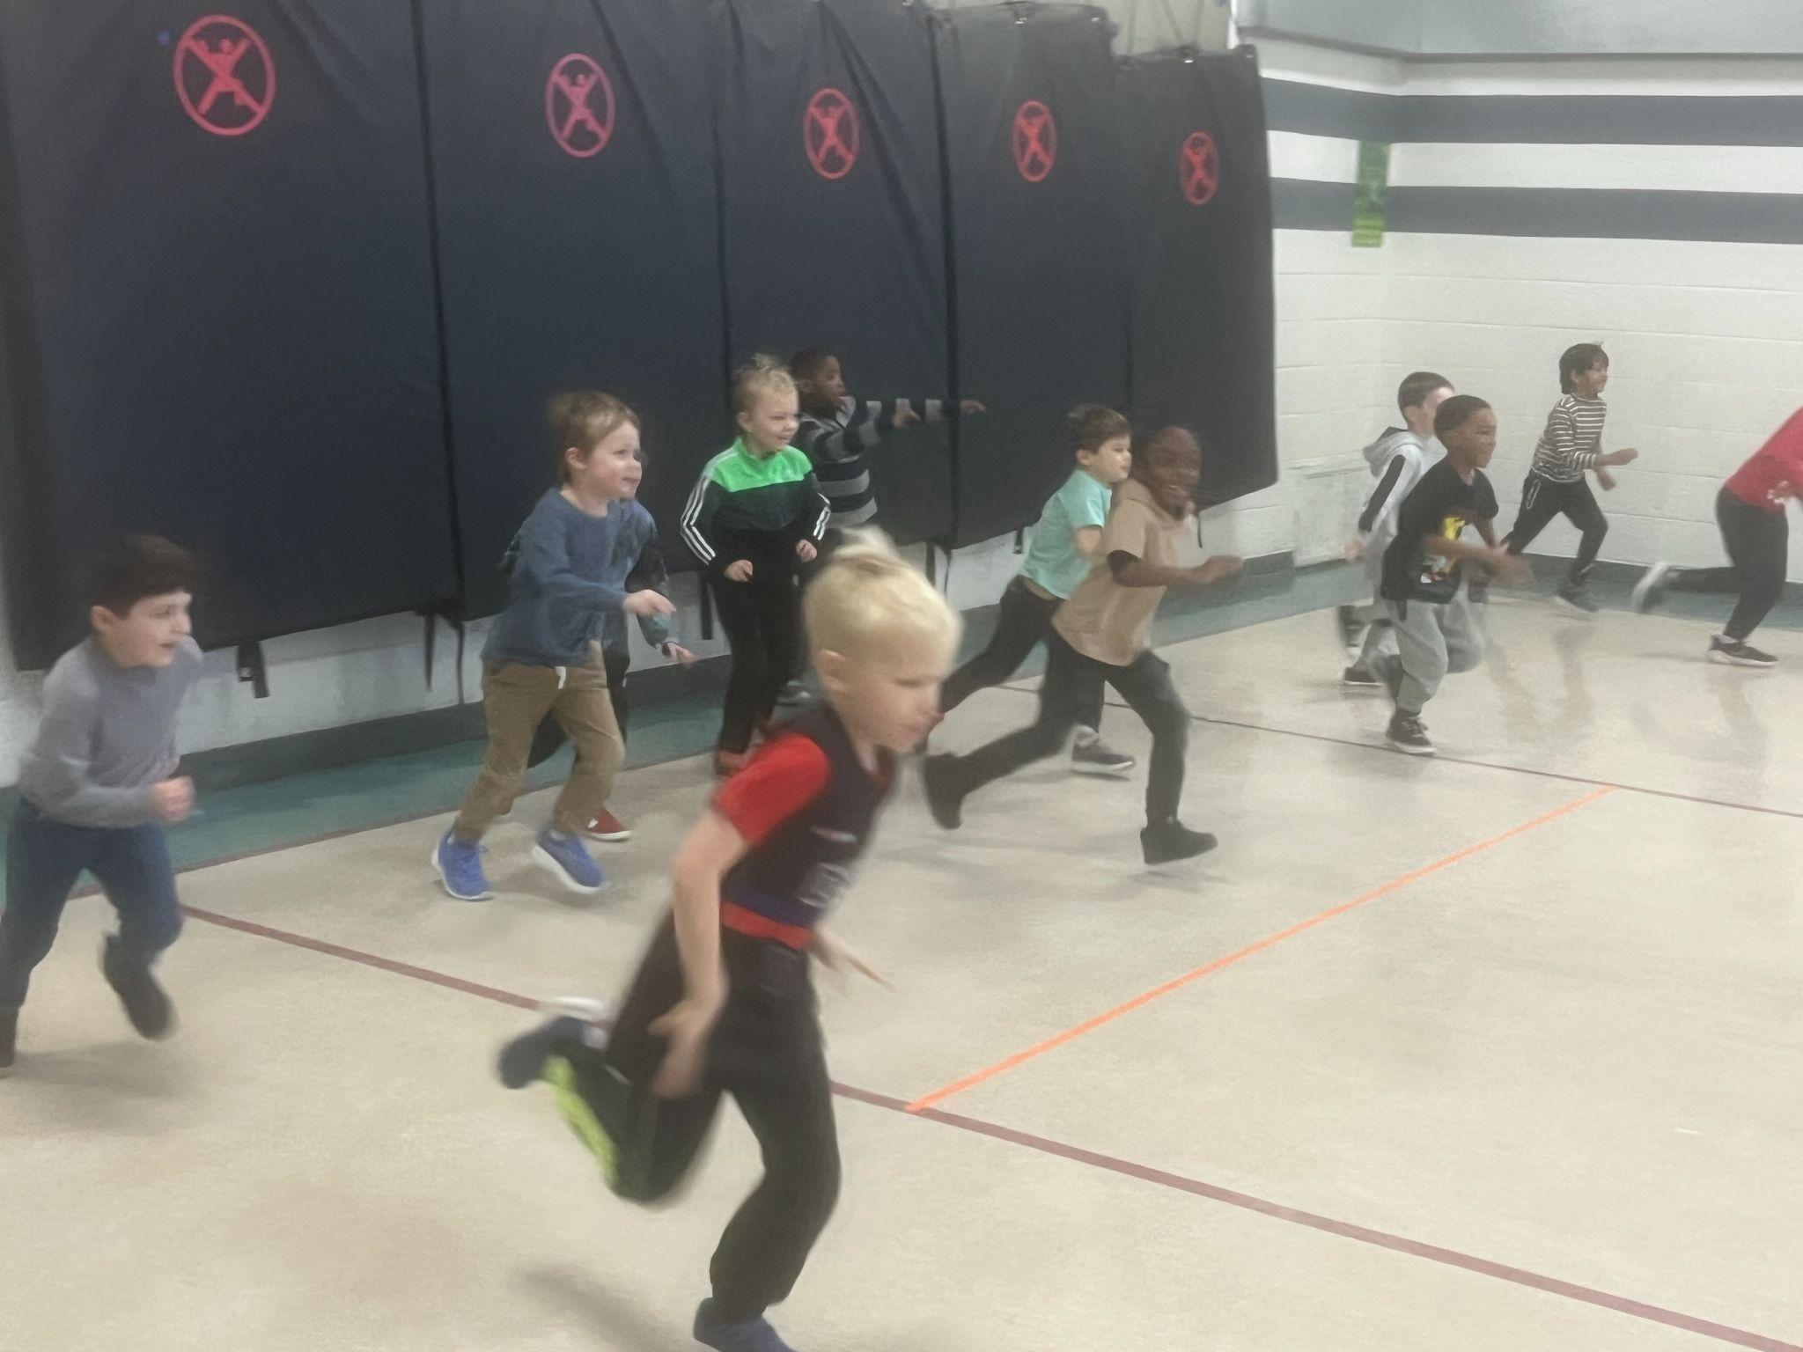
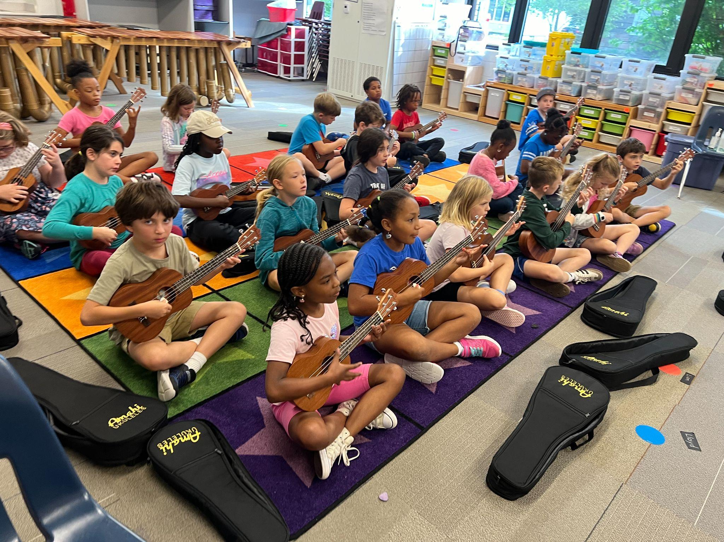
Academics
Reading and Writing
Math
Science
Social Studies
Special Subjects
Art
Music
Physical Education
Media (Library/Technology)
Spanish

Slide 8
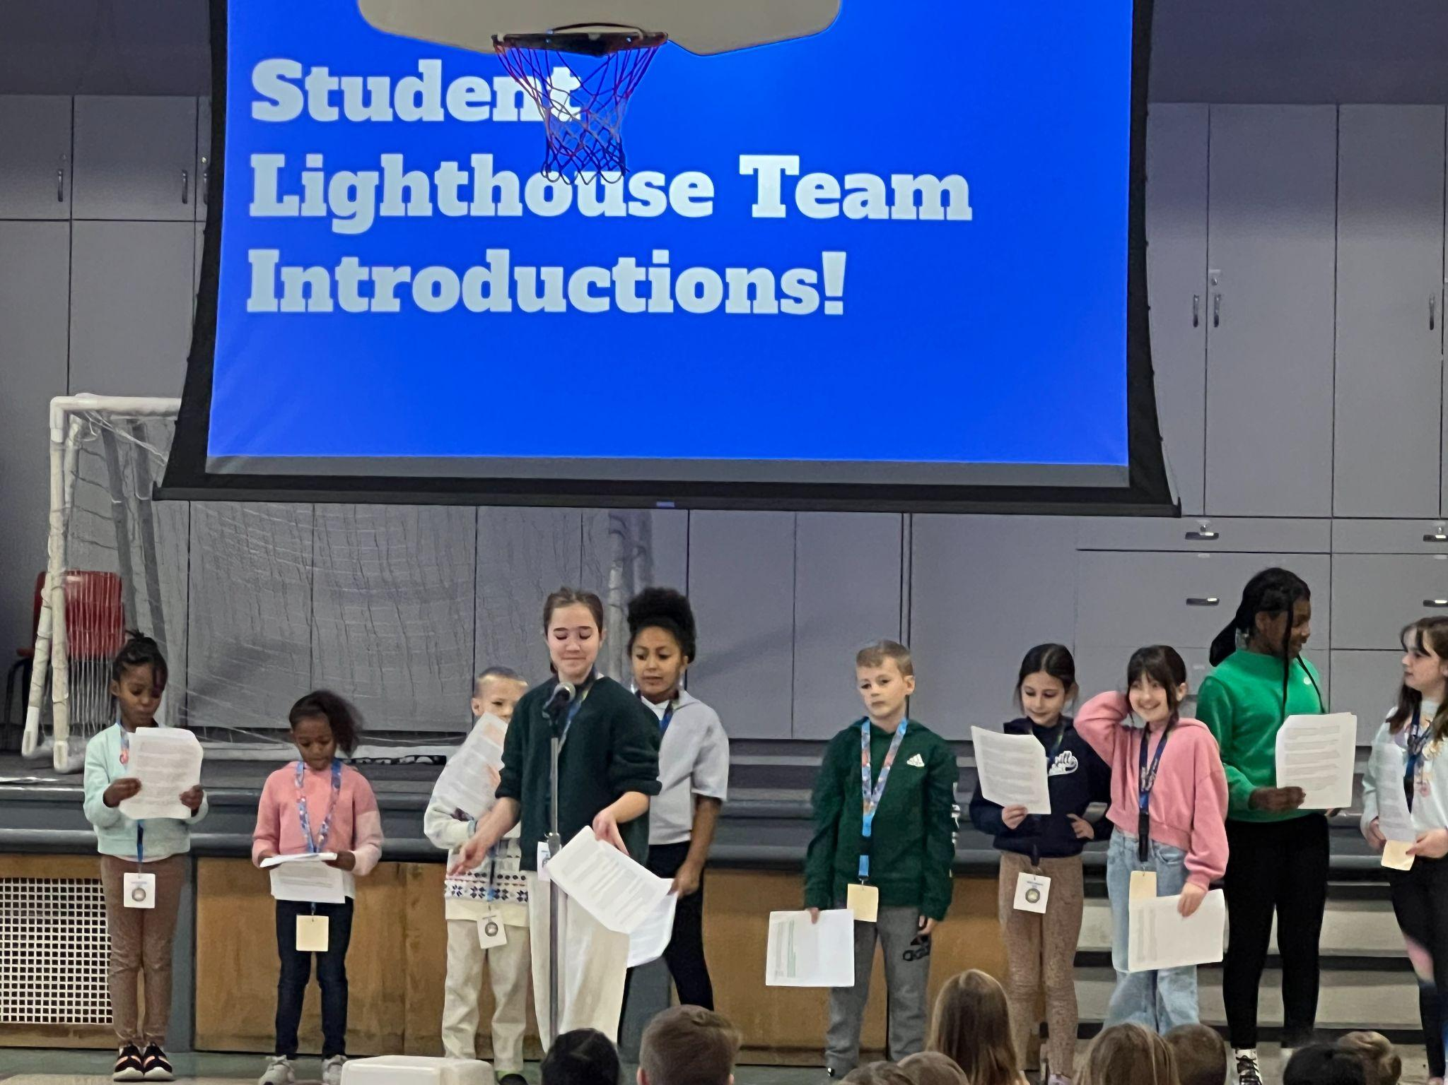
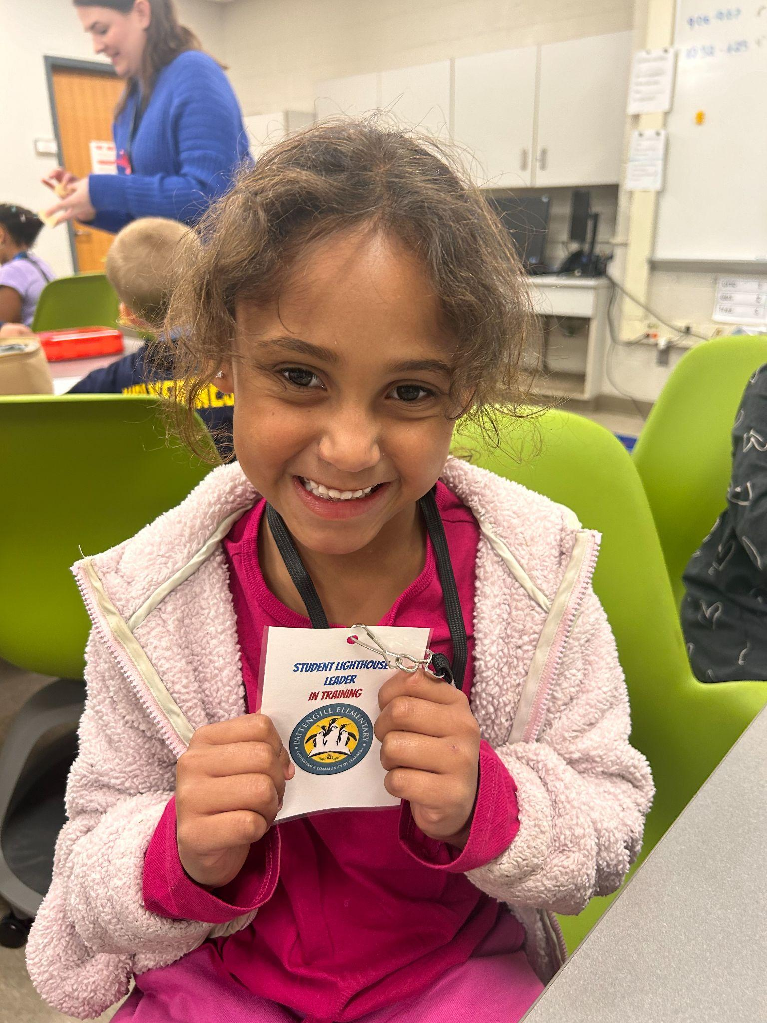
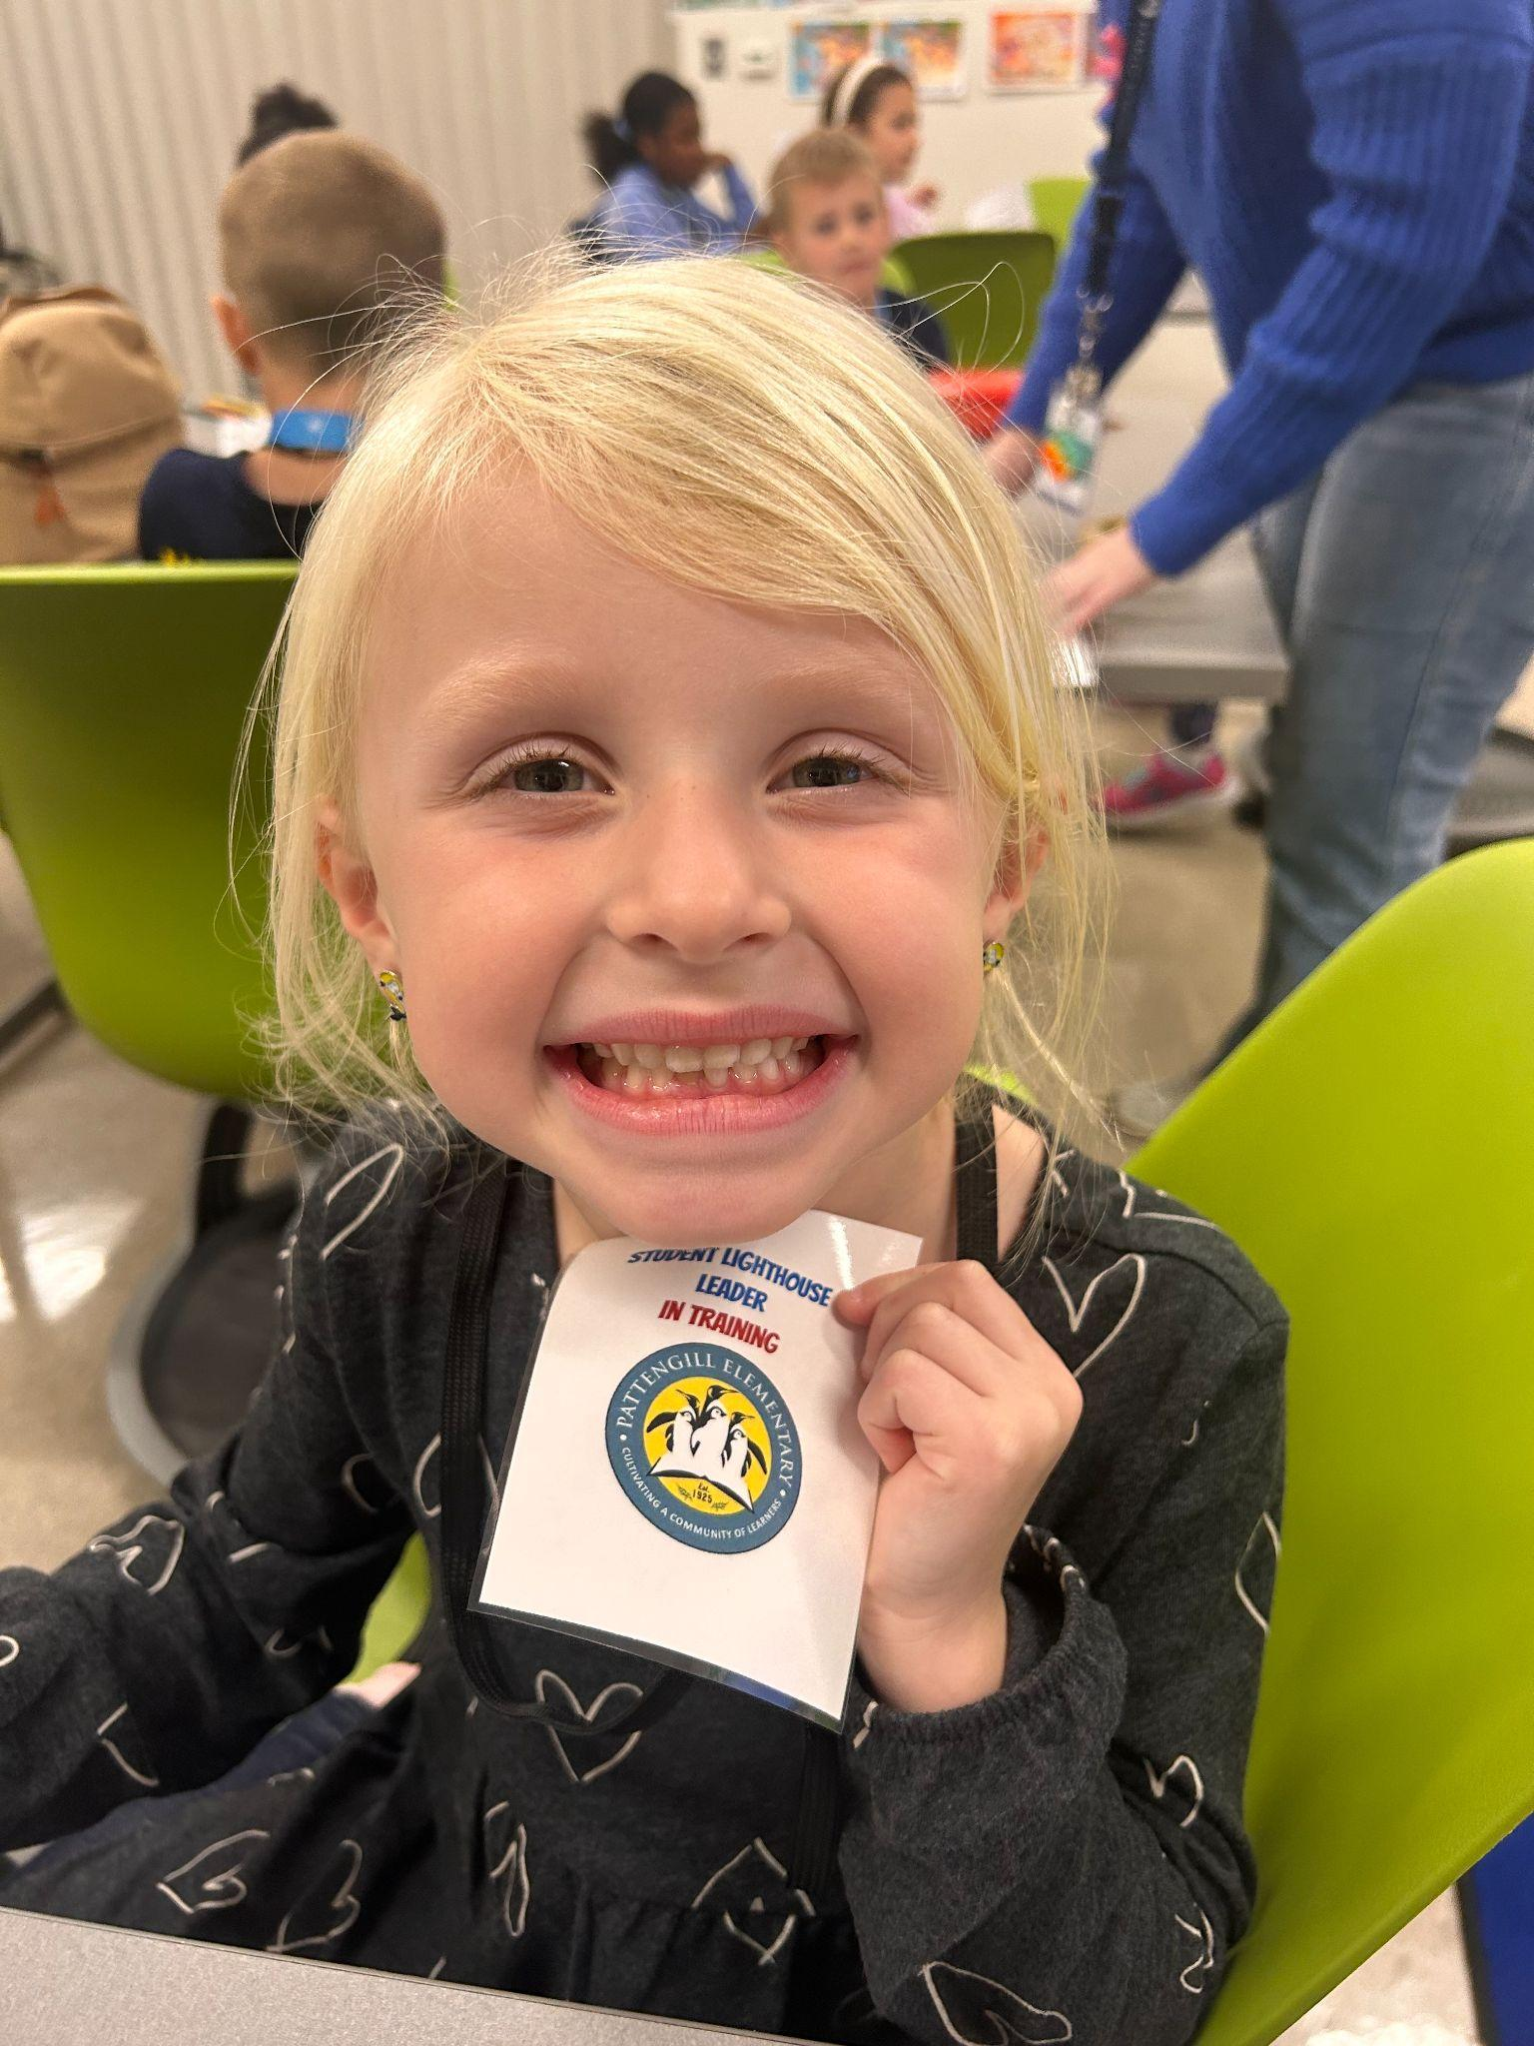
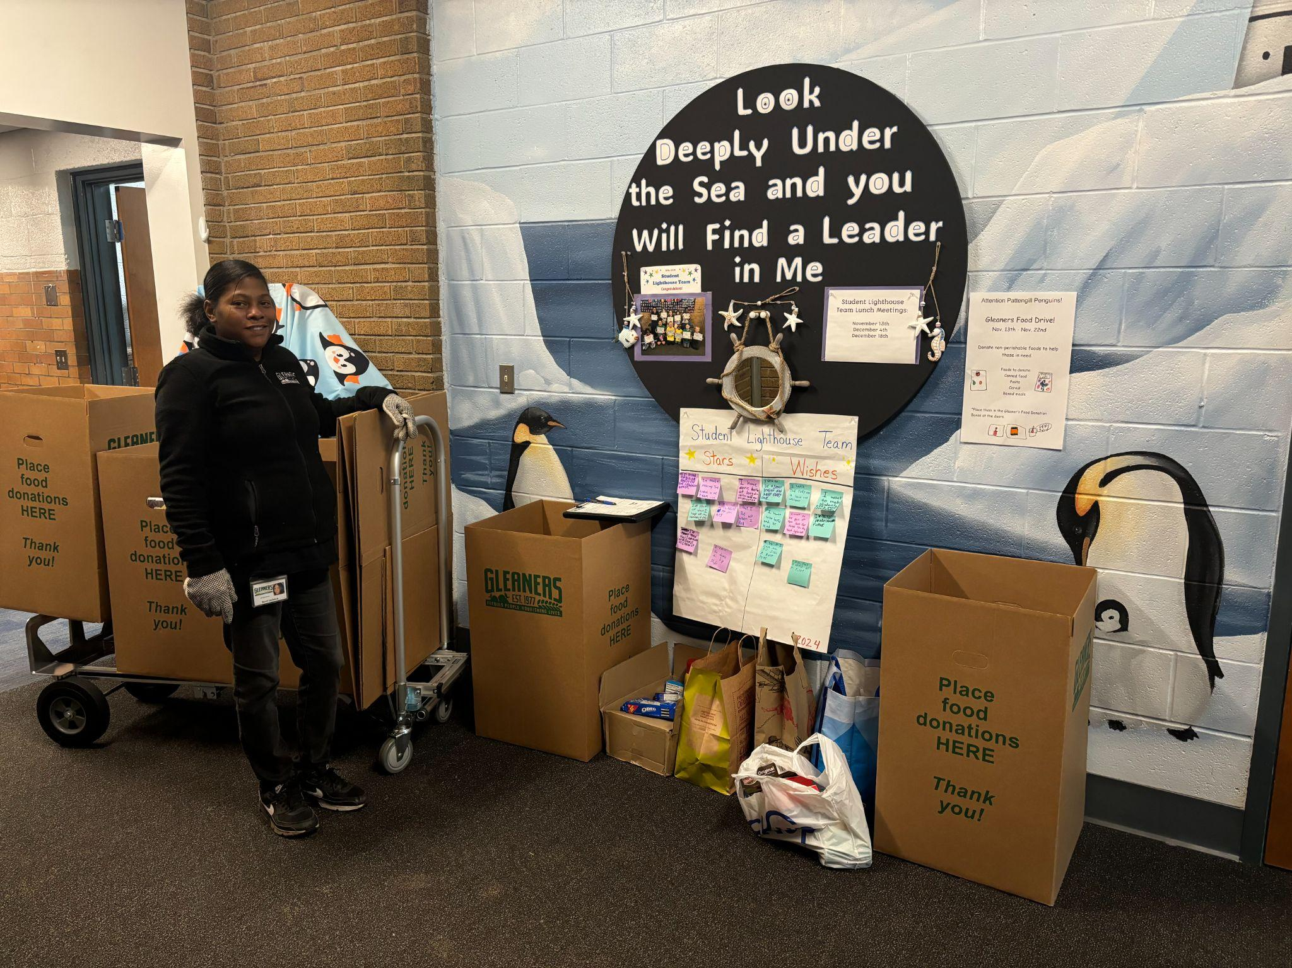
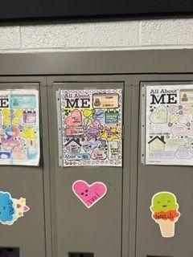
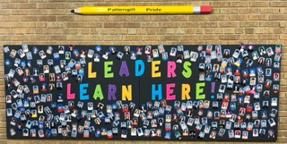
Leader in Me is a school-wide program designed to empower students with leadership and life skills. Leader in Me fosters a culture of accountability, collaboration, personal growth, and helps students become leaders of their own learning and lives. Every student can be a leader!

Slide 9
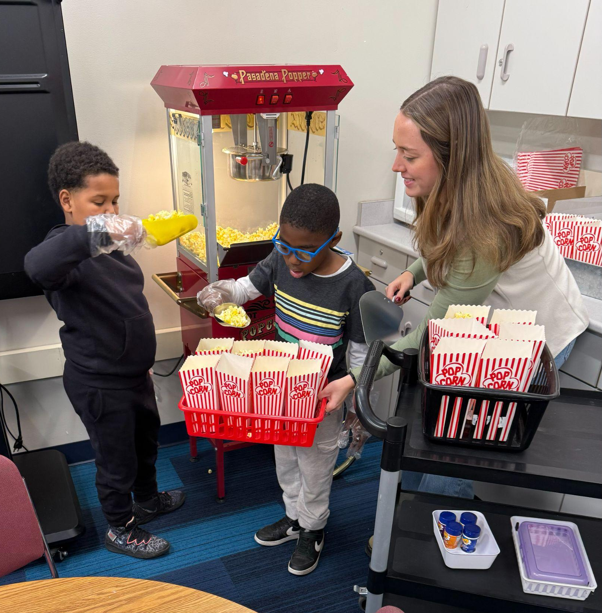
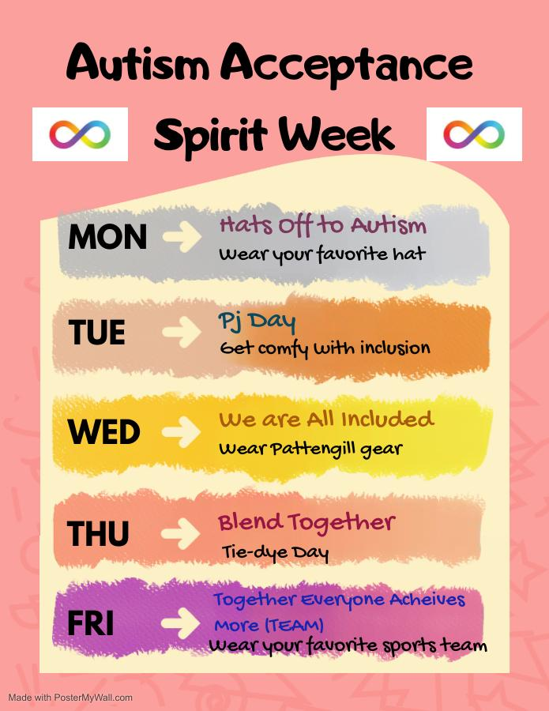
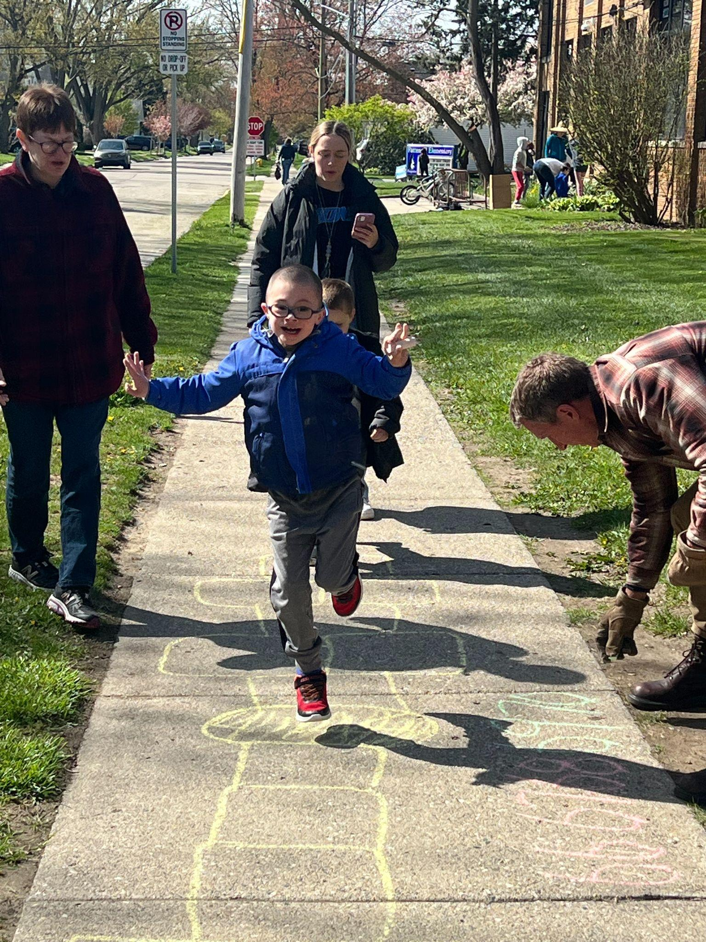
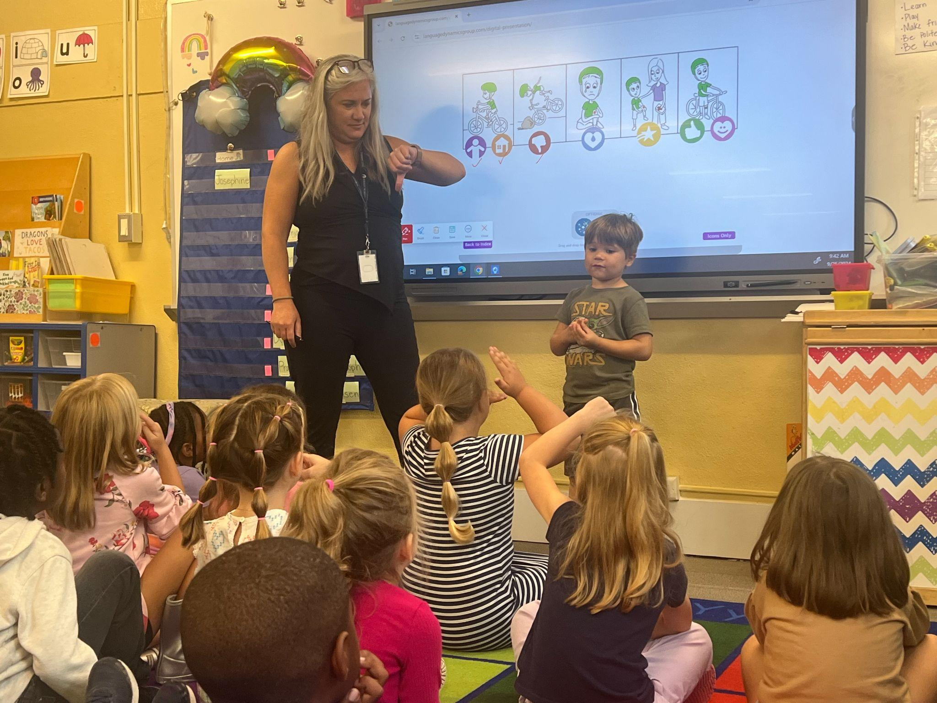
Support Services
Social Workers
Speech Pathologist
Resource Room Teacher
Physical Therapist
Occupational Therapist
Learning Interventionists
Learning Specialist
Paraprofessionals
ASD Consultant

Slide 10
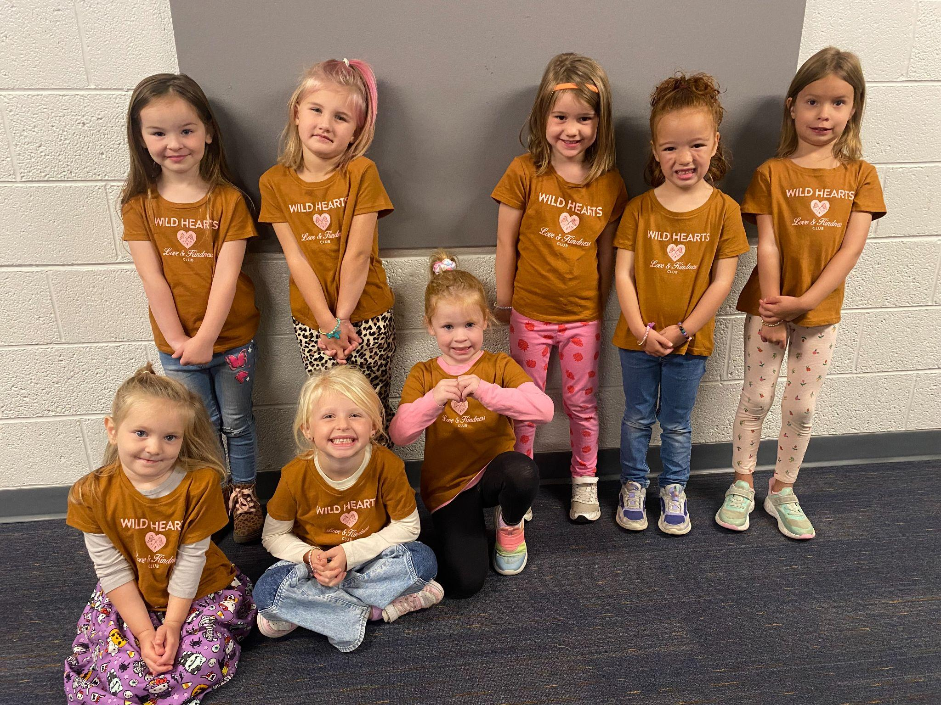
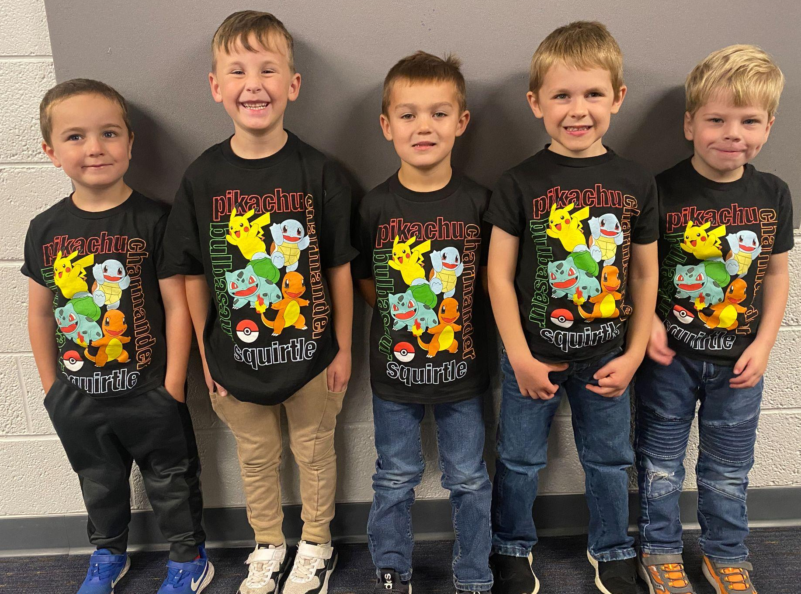
What is the Transitional Kindergarten program?
Specialized District program to meet the academic and social development of students who are not quite ready for regular Kindergarten
Placement is a joint decision between families and principals; A guided discussion will include:
readiness skills
stamina/attention span
preschool experience
academic skills
birthdate
level of independence

Slide 11
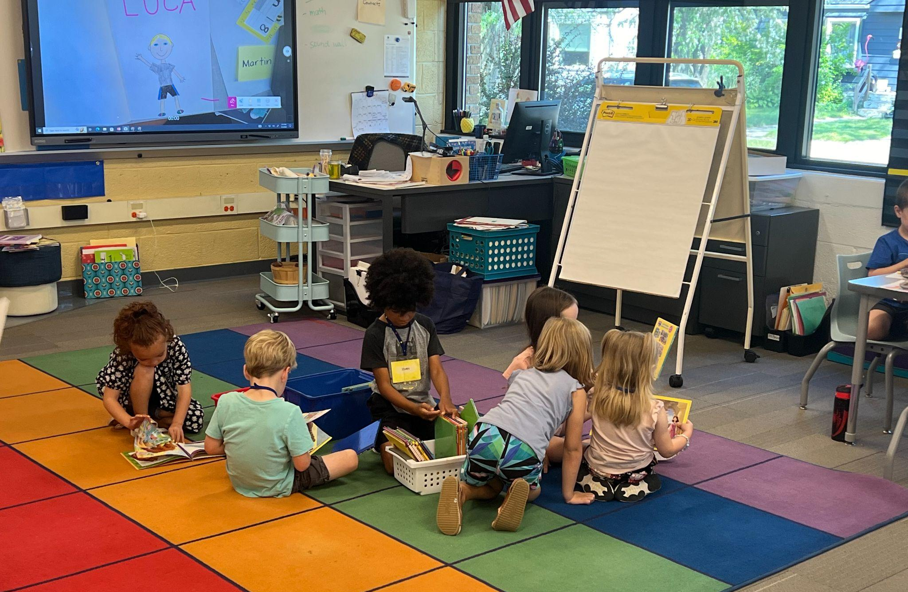
If you are considering Transitional Kindergarten, your child should be attempting to…..
Dress themselves, zip their coat, and tie their shoes
Use the bathroom independently
Take turns and share
Keep hands to themselves
Sit quietly to listen to a short story

Slide 12
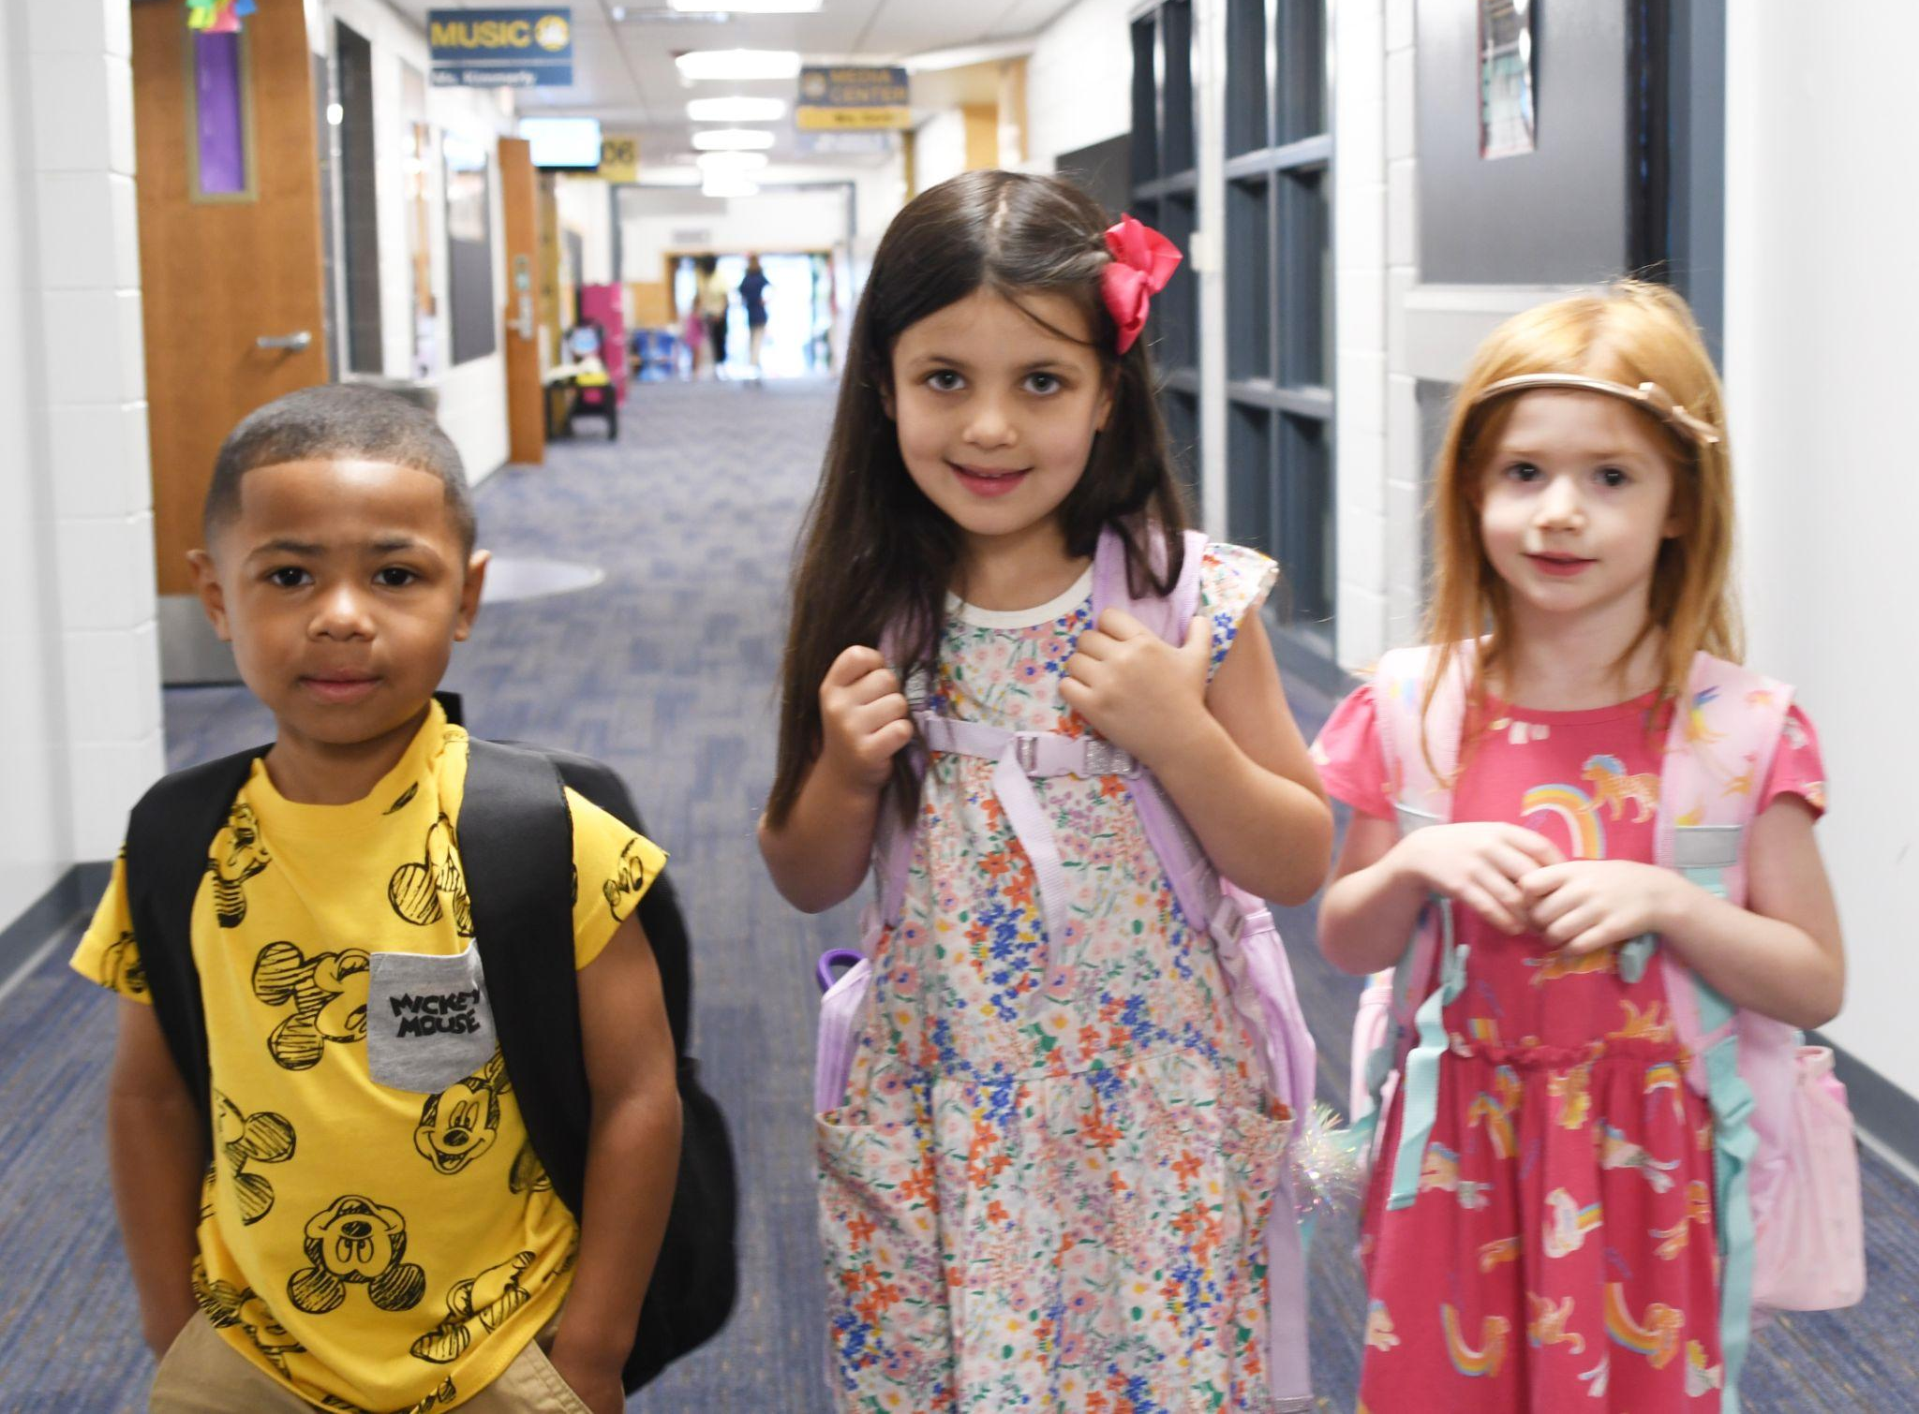
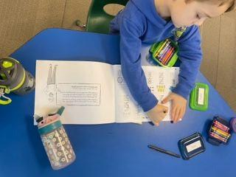
If you are considering Kindergarten, your child should be attempting to…..
Dress themselves, zip their coat, tie their shoes
Use the bathroom independently
Take turns and share
Keep hands to him/herself
Sit quietly to listen to a short story
Use a pencil
Separate from caregivers without becoming upset
Say their first and last name
Write their first name
Draw some form of a person
Count to 10 and recognize numbers to 5
Recognize colors and shapes
Recognize upper and lower case letters
Color, cut, and glue appropriately
Can rhyme and has some exposure to letter sounds

Slide 13
Does my child qualify for Transitional Kindergarten & Kindergarten?
Must be 5 years old by September 1, 2025
Transitional Kindergarten may not be available in all buildings. Locations are determined on District-wide needs after enrollment window has closed.
If a TK program is held in the child's home/neighborhood school, and there is more interest than space, a lottery will take place for TK placement.
Overflow students will be assigned to another school for TK.
Students will return to their home/neighborhood school for Kindergarten if they do not attend TK in their neighborhood school.
What is a waiver? Why would I need one?
Waivers are required for students who have a birthday between September 2 and December 1 and wish to enroll in TK and Kindergarten.
If I sign a waiver, I am saying my child is ready for TK/Kindergarten.
No student may enroll for TK or Kindergarten if they turn 5 after December 1, 2025.

Slide 14
Registration is Online!
For Berkley School District Residents
Enrollment Window – February 3-14, 2025
www.berkleyschools.org/enrollment
Enrollment takes place all online, including uploading required documents
NEW: Dental screenings are now required, in addition to health screenings, vision and hearing screenings and immunizations
Berkley Schools requires all documents to be turned in, including immunization records, prior to school starting. If your child won’t be able to have their 5 year old physical/immunizations prior to school starting, contact the Central Enrollment Office.
A school summary for your preschool will be sent after registration is completed.

Slide 15
Important Registration Information
Enrollment & Documentation Notes from Central Enrollment
The enrollment process starts on February 3. Please wait until then to register.
Child’s birth certificate is required. We cannot accept the “verification of birth”
Mortgage & tax statement must be original - not escrow statements - and the most recent statement
The two bills provided must be in either parent/guardian name, including address, company name and recent date on the statement
Parent/guardian that fills out the enrollment forms must provide their ID
Provide all document uploads at once, if at all possible
Paperwork must be new - cannot be from previously enrolled siblings
Please upload all documents through MISTAR, not via email
Health documents can be uploaded later if physicals, vaccines, etc. take place during the summer. All vaccines must be completed by the first day of school.
Call 248-837-8026 with questions

Slide 16
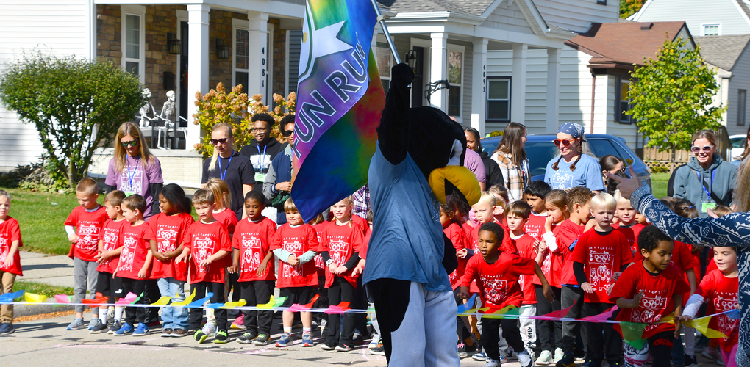
Schools of Choice Program (Non-residents)
Transitional Kindergarten through 5th grade – based on space availability
Open to all Berkley elementary schools
Oakland County residents only
Application Window: February 10 - 28, 2025
Berkley is a walking district; Transportation not provided
Building preference is not guaranteed
SOC students remain in BSD through graduation
Unless there is a break in enrollment
Notes:
16

Slide 17
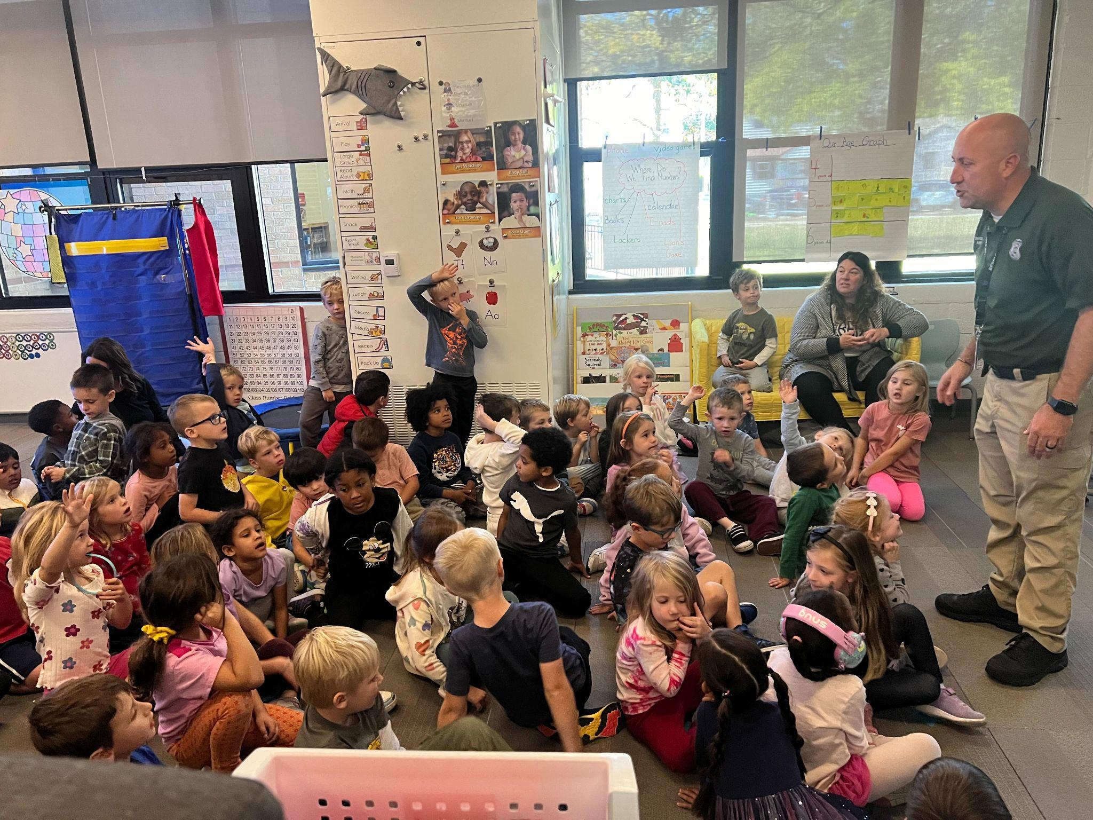
Transitional Kindergarten & Kindergarten Round-Up Dates
Angell – Thursday, May 15, 2025
Burton – Wednesday, May 21, 2025
Norup International – Tuesday, May 13, 2025
Pattengill – Thursday, May 22, 2025
Rogers – Wednesday, May 20, 2025

Slide 18
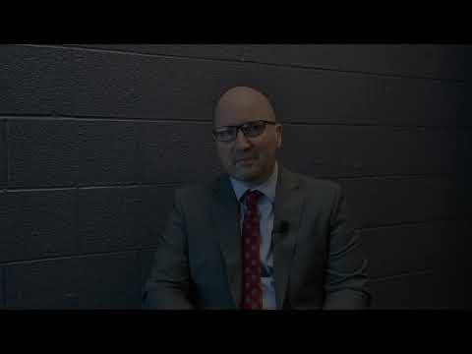
Watch this video welcoming you to the Berkley Schools from Superintendent Scott Francis and learn more about the enrollment process.

Slide 19
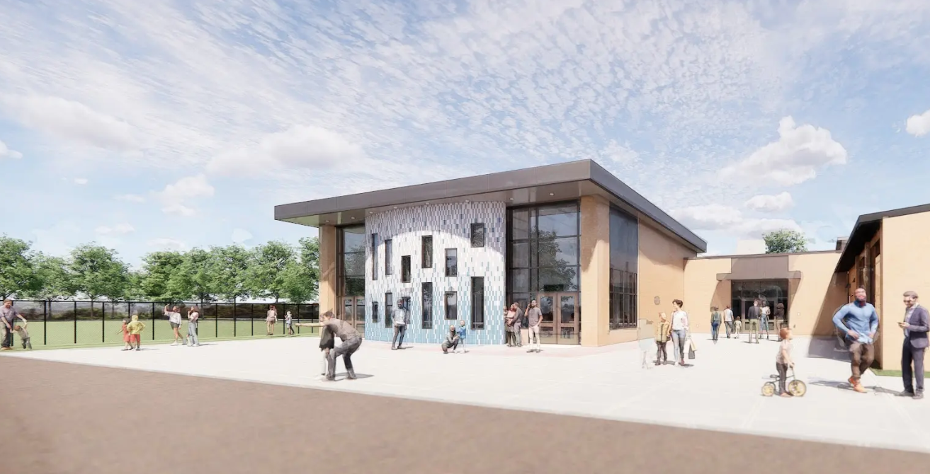
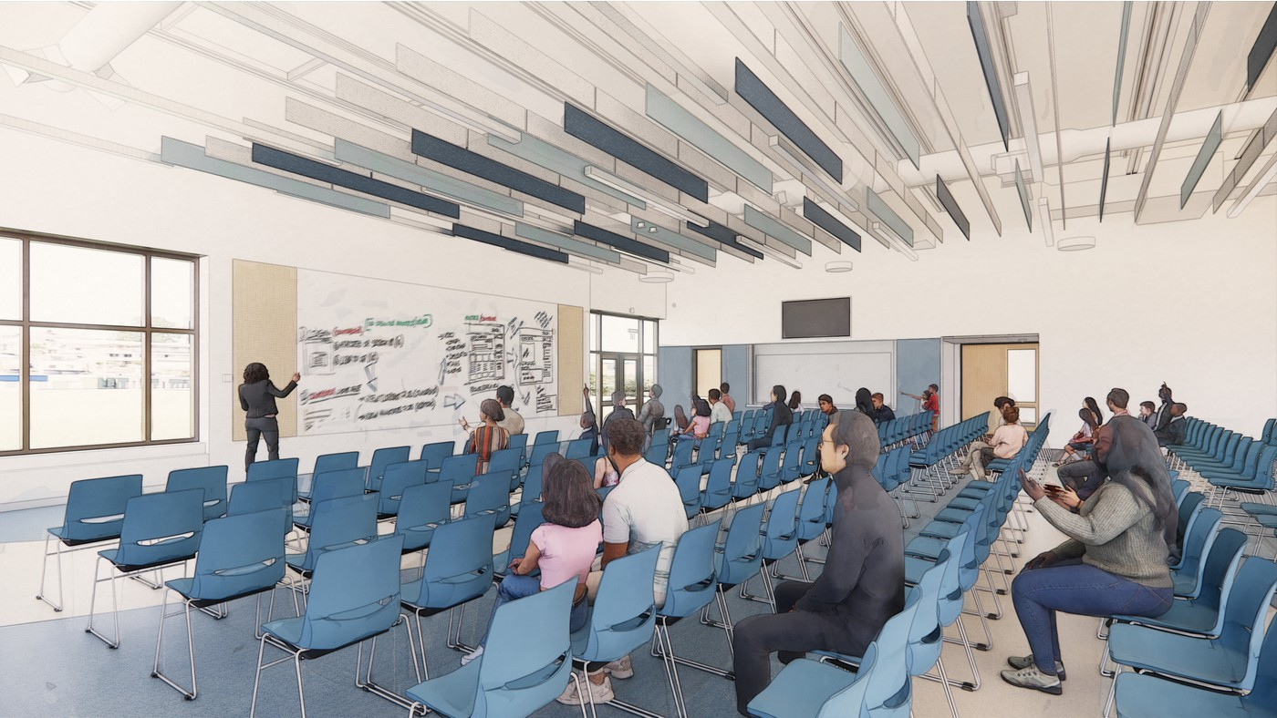
Thank you, voters!
From 2025-2026, the District will be experiencing construction projects to enhance our spaces and learning environments.
Elementary Cafeteria/Multi-Purpose Additions
New Furniture in All Classrooms
New Classroom Technology & Sound
Gym Updates
Many Updates at Berkley High School: Auditorium, Black Box Theatre, Band/Orchestra/Choir Rooms, Science Wing, Pool, New Field House + New Outdoor Fields, Expanded Parking
Updates to Hurley Field at AMS
Middle School Gyms
August 2023 Bond Passed

Slide 20
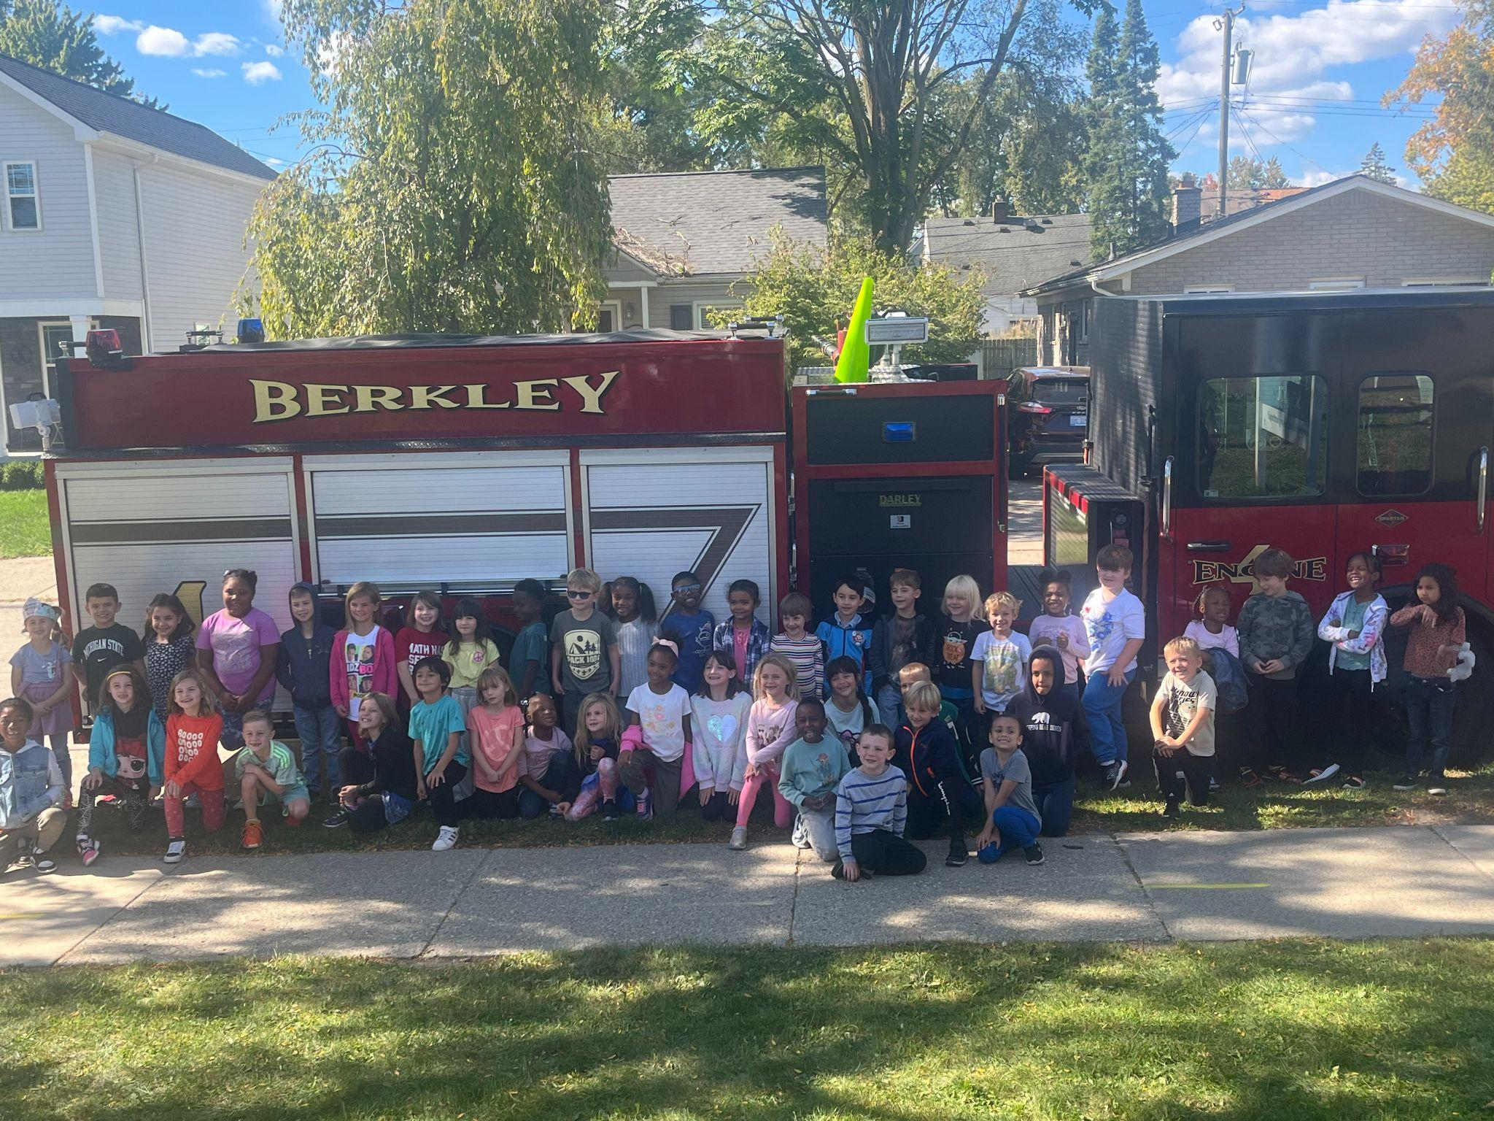
Stay Informed!
Weekly District eNewsletter, The Berkley Beat
Weekly school eNewsletter
Classroom notes from teachers
Facebook @BerkleySchools
Instagram @BerkleySchools
PTA social media + emails
District & school website
Many ways to know what’s happening in the Berkley Schools

Slide 21
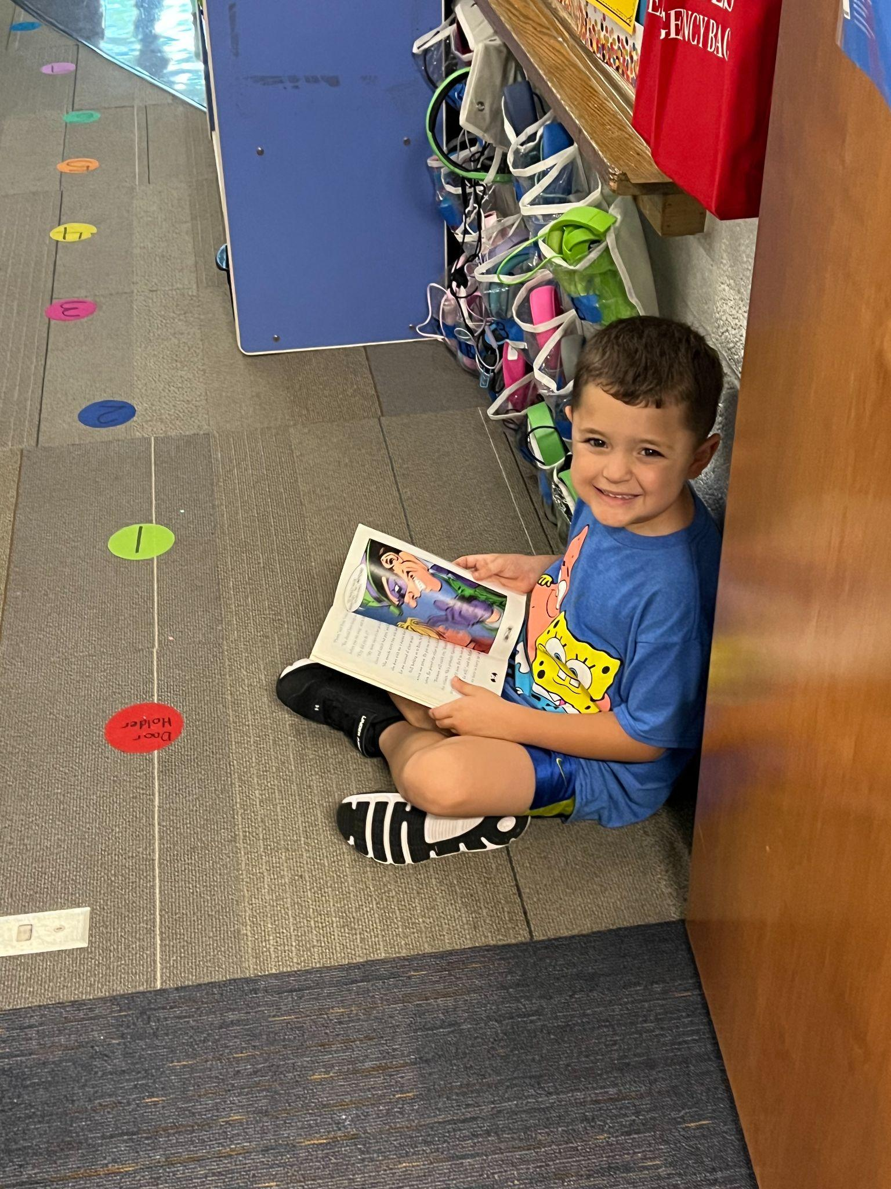
Questions?
Thank you for attending!
Don’t forget to sign in and let us know what your preference is for next year.

